Slide 1
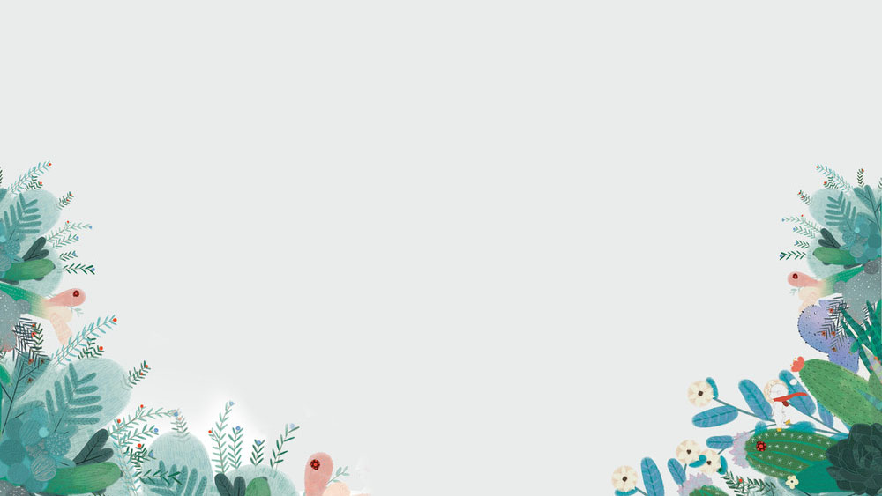
Five Things for Me when
I was a Child
1601 杨逐浪

Slide 2
01
patient

Slide 3

Refuse to impetuous.
Keep patience to do everything.

Slide 4
02
practice

Slide 5
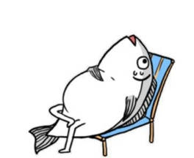
Spend less time at home.
Go out more and practice more.

Slide 6
03
reading

Slide 7
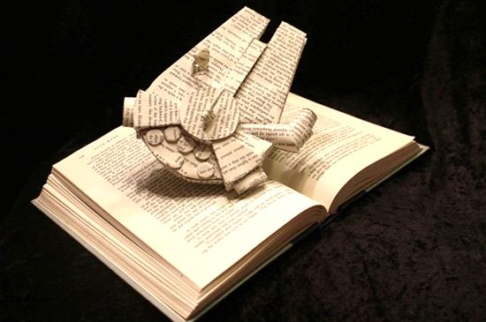
Have a good habit of reading. Make the most of the scattered time.

Slide 8
04
music

Slide 9
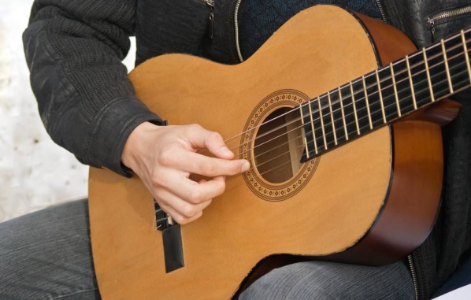
Learn music and master an
Instrument. This will make
your life more colorful.

Slide 10
05
freedom

Slide 11

Just be freedom.
Make it impossible for
everyone to imagine,
also includes yourself.

Slide 12
Thank you

